Slide 1

Enter the Deep Devlog

Slide 2
Idea:
Large open world => exploration of tons of different creatures (some hostile etc).
Simulated ecosystem of various species
Something similar to RainWorld and Subnautica
3D world - multiplayer
Programming ideas to get this to actually work:
Procedural animations => use a simple rig similar to RainWorld involving particle points on the body which the mesh attaches to at the key particle points

Slide 3
Net Code Problems
Creatures simulated by a lot of particles => that’s a lot of data to send across the net
Should the particles be client side simulated or only server side
In this way the client can predict / interpolate the system
Very computationally intensive
Essentially this is State Synchronization vs Snapshot Interpolation
State Synchronization
Has no problems extrapolating from a point
Makes client side prediction a lot easier
Redundant computation (server and client calculating physics)
Snapshot Interpolation
Has problems extrapolating from a point
No redundant computation
Client side prediction becomes a lot harder (maybe just don’t implement it at all)

Slide 4
Physics Engine problems (Unity)
Creatures simulated by a lot of particles => that’s a lot of computation power
Unity RigidBodies are not the most efficient thing => general coding
Work arounds
Make my own physics engine (Rainworlds solution)
It’s a little overkill
This means unity will be used as a renderer
I can control what is to be simulated and what wont be
E.g creature bodies not around players don’t need to be simulated
Other wise I just have to work with unity and just make do with how it is

Slide 5
Game Code
As discussed before big problems with unity engine, thus writing my own.
Languages:
C#
I know what im doing
Slower and less control over optimization decisions
A lot more c support is given for stuff like game engines
C
No idea what im doing
Greater control
A lot more support
Able to use systems like openmp (will need to run separate tests to check performance difference between handcrafted threads etc)
Able to abuse SIMD and AVX AVX2 (advanced vector instructions etc)
To solve the problem of rendering:
the server and game engine with simulation etc can be written in c for efficiency and more control
Ill need to learn some addition things to get the server to use the GPU for certain things
the c server can send udp packts to c# clients running which c# decodes to render using unity
this means my server archintecture is snapshot interpolation rather than state synchronization as the c# clients cannot simulate physics without the c game engine
the c server and gameengine can technically be interfaced with via unmannaged dll from c# but i think thats not the best option since dll and c# memory management has bad overhead
coding the game engine in c# would solve this issue but the lack of control over the optimization may hurt
directx is c and has hlsl support but for cross platform i gotta figure somethin else out

Slide 6
Physics
Separation of Physics Objects and Entities
Have Entities own the physics objects they require (similar to bodychunks in rainworld) and have active physics objects referred to in the physicsworld and entities control whether they are active or not.
For performance in the case of data oriented design, have all physics objects stored in the physics world where entities have pointers to them such that all physics objects are together and all entites are together
Might need to reconfigure stuff like this when it comes to true data oriented design where all positions are put together, all velocities are put together etc…

Slide 7
Network
Problem with Endianness
Function to check endianness
Clients agree to use same endianness as server
Simply easier to code as clients only have to do conversion instead of server as well
Network packets header design
See Enter the DeadZone

Slide 8
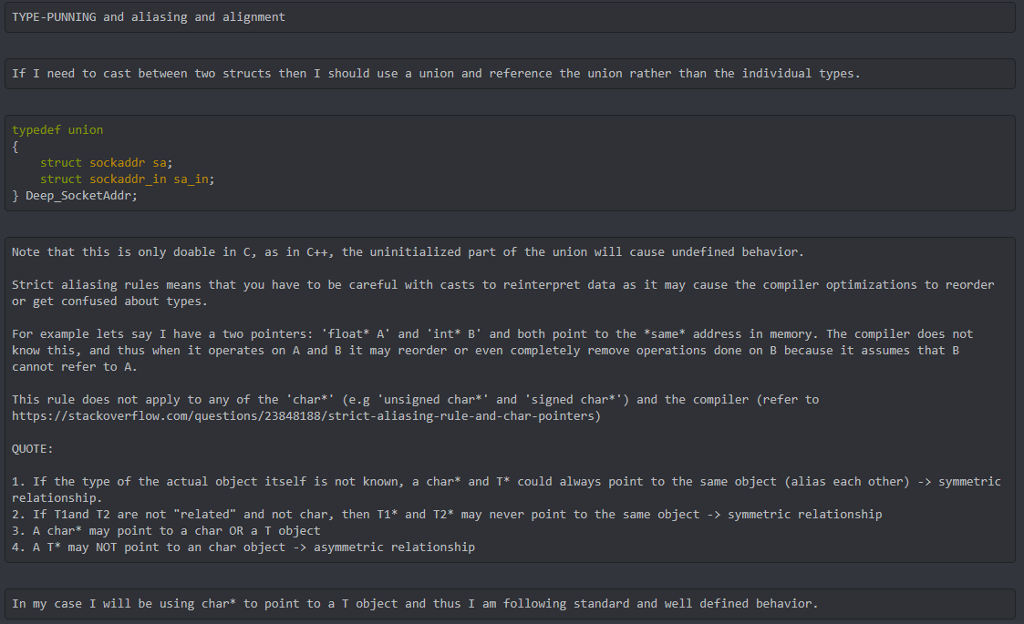
C - Containers
Problems with scaling arrays is that realloc does not invoke copy constructors and also copy constructors don’t exist in C, make it such that you can use a variation of a container if the ECSHandle for a component flag says the component is not copy safe (requires user-defined copy constructor)
In C++ lets say I store an entity which contains a std::vector or std::unordered_map, then my code will break because I do not call their constructors on realloc. In C I can guarantee that my types are POD and bit-copy safe.

Slide 9
Engine (ECS)
Uses ECS Archetype implementation
https://ajmmertens.medium.com/building-an-ecs-2-archetypes-and-vectorization-fe21690805f9 (based on)
Entity Hierarchy system
ECS_ID for naming components to make them readable and debbugable
EntityHandle uses specific bit pattern
At the moment the last 8 bits specify the type role (e.g Parent (hierarchy), Instanceof (prefabs) etc…) when it comes to components
Generator system as described by link above to prevent reuse of deleted objects
Entity Hierarchy =>
{
//BASE REQUIREMENTS
1 : [1, 2], //DEEP_ECS_COMPONENT
2 : [1, 2], //DEEP_ECS_ID
3 : [1, 2], //Describes a component
4 : [2, 3], //Entity that uses component 3
5 : [2, 3] //Entity that uses component 3
}
Archetype Component Listing =>
{
[1, 2] : [1, 2, 3]
[2, 3] : [4, 5]
}
As you can see here, the hierarchy describes entity and component types, when it comes
to entities owning components,the EntityHandle of the entity is used to find the component
in the "Component Listing". In this way, entities have their own components. You may also
notice that Components have Components (as can be seen by component 3 having component 1
and 2). The disadvantage of this system means that entities cannot share the same component
instance, but this can be implemented using the Type Role system where the last 8 bits of
the EntityHandle represent a type role such as "INSTANCEOF" etc... (E.G through the use of
"REFERENCEOF").
The method described here: https://ajmmertens.medium.com/building-an-ecs-2-archetypes-and-vectorization-fe21690805f9
works fine, and the graph for adding and removing stuff is good, I want to implement that.
However, the struct of arrays approach is indeed very good but with archetypes the non-interweved memory layout can be a problem:
(https://stackoverflow.com/questions/57560161/what-cpu-cache-does-while-accessing-multiple-arrays)
To solve this I will use the hybrid approach of struct of arrays of structs:
struct Container
{
A[8]
B[8]
C[8]
}
I should first profile this in another project
Container[N]
to get the best of both worlds, see : https://stackoverflow.com/questions/40163722/is-my-understanding-of-aos-vs-soa-advantages-disadvantages-correct
and: https://en.wikipedia.org/wiki/AoS_and_SoA#:~:text=Most%20languages%20support%20the%20AoS,support%20a%20data%2Doriented%20design.
Another problem to address is the use of vector* causing the actual data of the vectors to be allocated far from each other (doesnt help with spatial-locality).
I should have archetypes have their components stored locally as shown in the Container example above, and not as:
struct Container
{
std::vector<> A
std::vector<> B
std::vector<> C
}
This would involve me creating a new container to handle this, and would most likely involve my own implementation using C style arrays.
Another issue that isn't mentioned in the example implementation this is based on are sub archetypes.
Say 2 archetypes exist:
[1, 2]
[1, 2, 3]
Lets say a system iterates over the sub archetype [1, 2], so [1, 2, 3] should also be iterated over.Cache misses could then occure.
This can be fixed having copies of components, but then there is the cost of copying values to keep them synchronized. This becomes
worse with:
[1, 3]
[1, 2]
[1, 2, 3]
[1, 2, 3, 4]
Thats a lot of copies.And I dont think it'll be worth it.
It is best to just have a system operating on [1, 2] to loop through all archetypes that contain [1, 2]. Due to needing to check and perform
these comparisons, the algorithm for "hashing" these archetypes should probably be a bitset one such that I can simply perform an "or" operation
and "and" bit operation to compare archetypes (much like bit flags).
A cache efficient growing array could be abusing pointer casts using:
struct Array
{
int Size;
}
then malloc the sizeof(Array + (number of elements * sizeof(type))) then use the void*, and then to access elements simply cast to Array* and + sizeof(Array)
and treat as normal array with []. Need to check how to free such memory tho (https://stackoverflow.com/questions/2182103/is-it-ok-to-free-void) aight its all good :D.
According to my profiling, the difference between AoS and SoA is pretty much non-existant (this could also be as a result of not using a large enough struct in the AoS so
the cache was probably still usable. However, these approaches were definitely way better than having stuff mixed up in memory.
When it comes to accessing multiple arrays that are far apart from each other, seems to be faster than the SoA ???? (This is very strange). I think the compiler is probably
hiding something from me and optimzing something away. As on debug build (no optimizations), it shows that SoA is faster as expected, by 2x.
When it comes to implementing adding entities, I will need to change how I implemented creating archetypes such that
it generates the component list for its types as well. To do this I will need to change how I store components, I will probably have to write my own
container using malloc and realloc etc, due to the limitations of vector<T> (not being able to store arbitrary vector and create typeless vectors).
I will also need to handle components having destructors, removing components, ECSHandle management etc...
I will probably still retain std::vector<ComponentList> as managing and malloc and realloc a multidimensional array is a huge pain, and thus I will only make
ComponentList be unmanaged using my own malloc and realloc. This also means I can handle index allocations.

